Slide 1

National University of Computer and Emerging Sciences
Attention is All you Need
(Transformers)
AI-4009 Generative AI
Dr. Muhammad Nouman Noor
Department of Artificial Intelligence and Data Science

Slide 2
Goals
Today’s Lecture
Attention is All you Need (Transformers)
Vision Transformers (ViT)

Slide 3
Recap of Previous Lecture

Slide 4
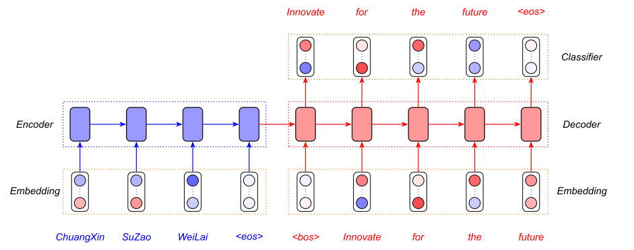
Introduction
Sequence transduction
https://www.analyticsvidhya.com/

Slide 5
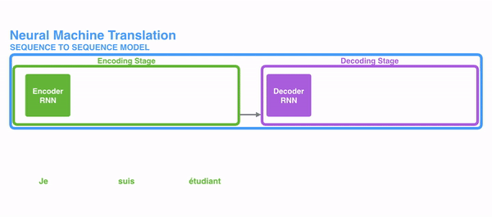
Introduction
Sequential nature prohibits parallelization within training examples
Critical at longer sequence lengths and memory constraints limit batching across examples.
More difficult to learn longer dependencies between inputs.
Some suggested improvements for computational efficiency:
Factorization tricks
Conditional computation
Still constraint of sequential computation remains.

Slide 6
Introduction to Transformer
Self-attention: Also known as "scaled dot-product attention"
It is a mechanism where each element in a sequence computes its attention score with respect to every other element in the same sequence, including itself.
It calculates weights for every word in a sentence as they relate to every other word in the sentence, so the model can predict words which are likely to be used in sequence.
The self-attention mechanism allows each word to attend to every other word in the sequence in parallel, weighing their importance for the current token.
Models can “learn” the rules of grammar, based on statistical probabilities of how words are typically used in language.

Slide 7
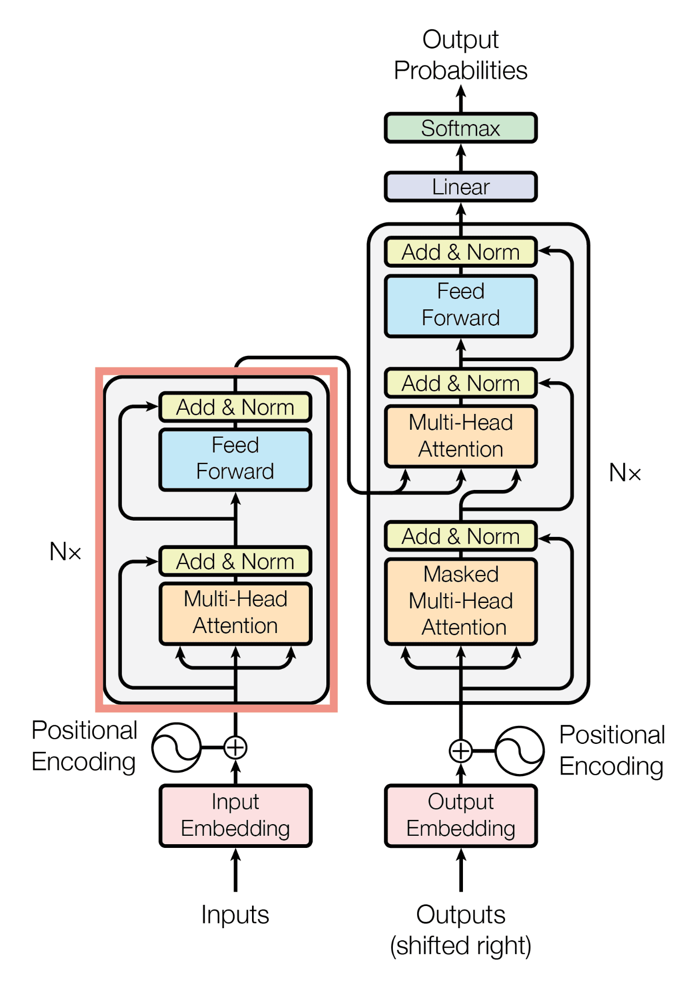
Transformer Model Architecture
The Transformer follows this overall architecture using stacked self-attention and point-wise, fully connected layers for both the encoder and decoder

Slide 8
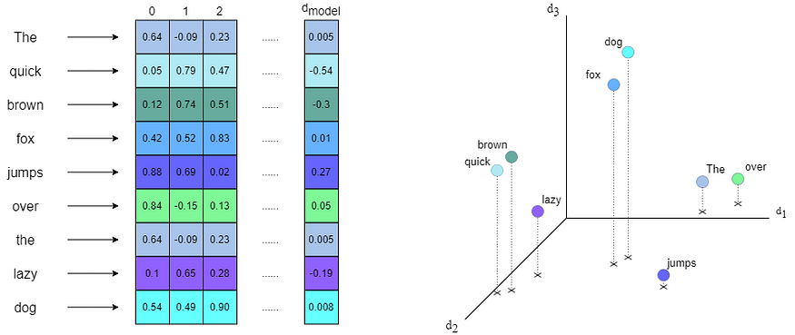
Transformer Model Architecture

Slide 9

Positional Embedding
https://medium.com/

Slide 10

Attention Mechanism
“The animal didn't cross the street because it was too tired”
What does “it” in this sentence refer to?
When the model is processing the word “it”, self-attention allows it to associate “it” with “animal”.

Slide 11
Today’s Lecture

Slide 12
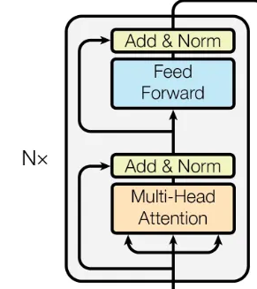
Attention Mechanism
The attention mechanism is at the core of the transformer architecture
The attention mechanism enables the model to assign different attention weights/scores to different tokens in a sequence
Why?
More importance to relevant information,
Ignore irrelevant information,
Effectively capture long-range dependencies

Slide 13
Scaled Dot-Product Attention
The attention mechanism distinguishes three inputs:
The query Q, the key K, and the value V.
Each token in a sequence is a separate input for Q, K, or V.
The Attention mechanism compares queries Q with keys K to determine their importance/compatibility to each other, computing attention weights.
The attention is called "Scaled Dot-Product Attention".

Slide 14
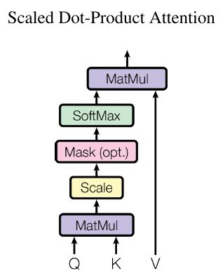
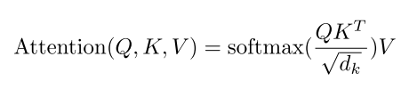
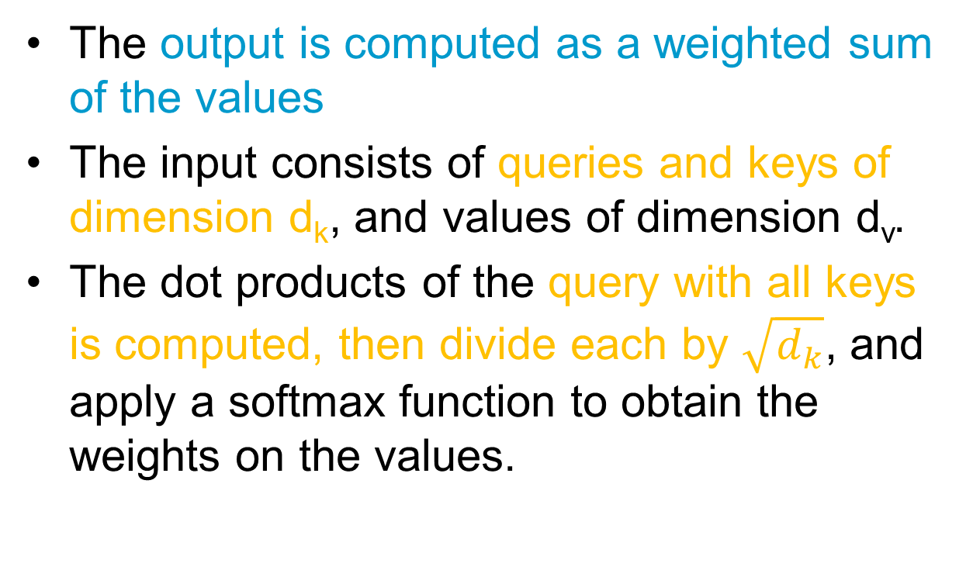
Scaled Dot-Product Attention
The output is computed as a weighted sum of the values
The input consists of queries and keys of dimension d_{k}, and values of dimension d_{v}.
The dot products of the query with all keys is computed, then divide each by $\sqrt{d_{k}}$, and apply a softmax function to obtain the weights on the values.

Slide 15
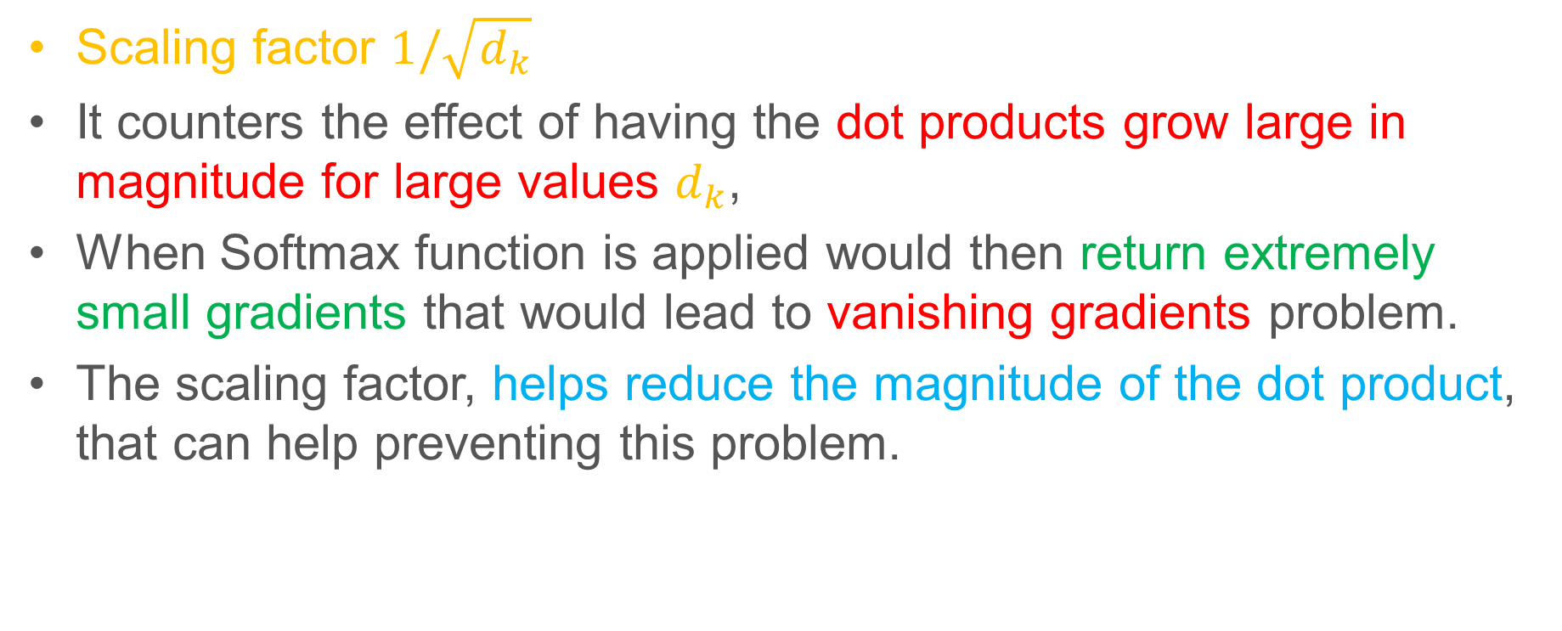
Scaled Dot-Product Attention
Scaling factor $1/\sqrt{d_{k}}$
It counters the effect of having the dot products grow large in magnitude for large values $d_{k}$,
When Softmax function is applied would then return extremely small gradients that would lead to vanishing gradients problem.
The scaling factor, helps reduce the magnitude of the dot product, that can help preventing this problem.

Slide 16
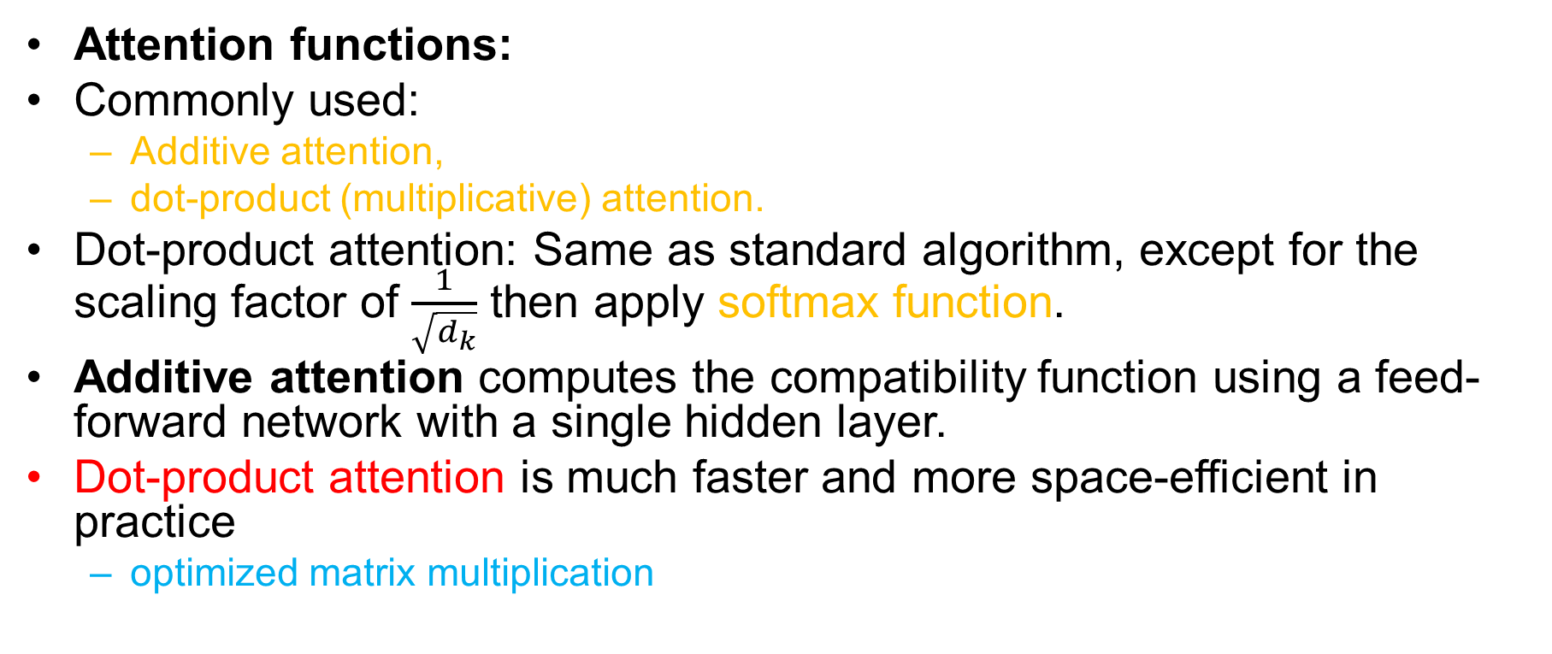
Scaled Dot-Product Attention
Attention functions:
Commonly used:
Additive attention,
dot-product (multiplicative) attention.
Dot-product attention: Same as standard algorithm, except for the scaling factor of $\frac{1}{\sqrt{d_{k}}}$ then apply softmax function.
Additive attention computes the compatibility function using a feed-forward network with a single hidden layer.
Dot-product attention is much faster and more space-efficient in practice
optimized matrix multiplication

Slide 17
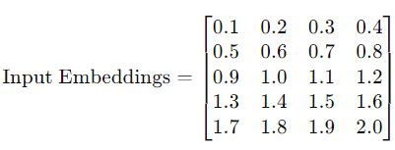
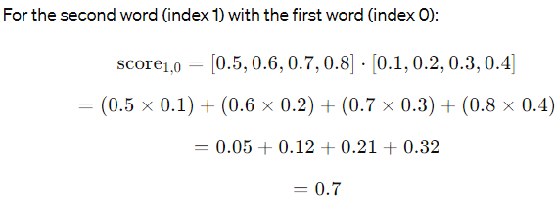
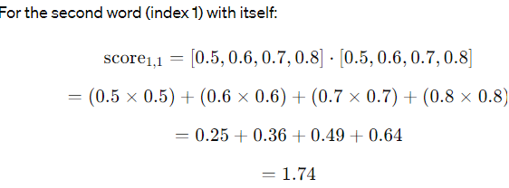
Scaled Dot-Product Attention
Example: Query Q= [0.5,0.6,0.7,0.8]
For the second word (index 1), the attention score with the first word (index 0):

Slide 18
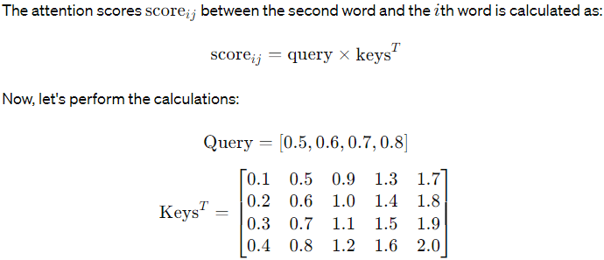
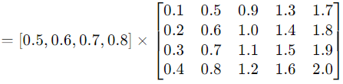
Scaled Dot-Product Attention

Slide 19
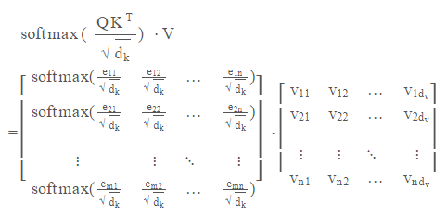
Scaled Dot-Product Attention

Slide 20
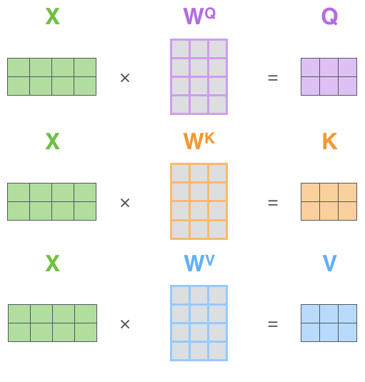
Scaled Dot-Product Attention
To calculate the Query, Key, and Value matrices, the embeddings are combined into a matrix X
We then multiply X by the weight matrices to get Q, K and V

Slide 21
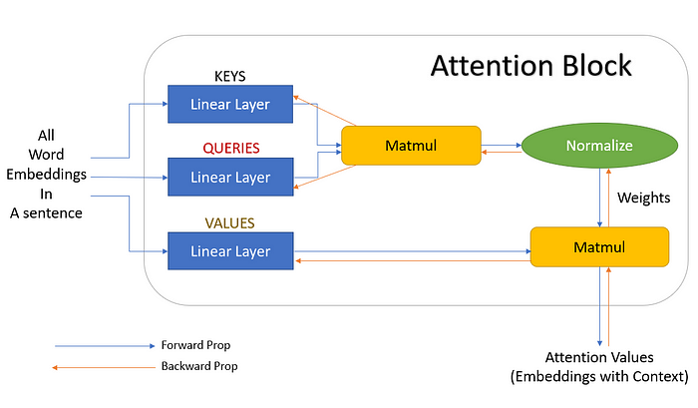
Scaled Dot-Product Attention
towardsdatascience.com

Slide 22
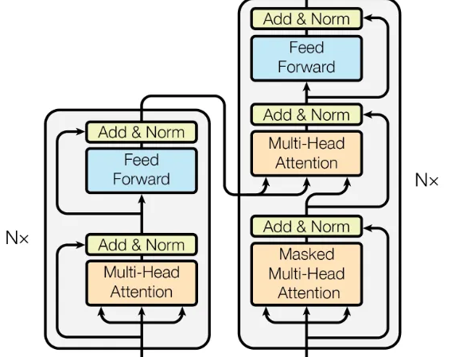
Self-Attention & Cross-Attention
Self- and cross-attention only differ in which tokens are given as inputs Q, K, and V.
In self-attention, the same tokens are used for all three inputs
In cross-attention, the same tokens are given to K and V, but different tokens are used for Q.

Slide 23
Multi-Head Attention
Consider the following sentence:
"The professor at FAST NUCES didn't assign the project because it was too involved.”
It allows the model to jointly attend to different positions and learn multiple representations of the input sequence simultaneously.
Perform multiple sets of attention computations in parallel
It captures diverse aspects of the input sequence and enhances the model’s ability to capture complex dependencies.

Slide 24
Multi-Head Attention
It can improve the model’s ability to focus on different parts of the input data simultaneously.
Multi-head attention is to run the attention mechanism multiple times (or "heads") in parallel, with each head having its own set of learned weights.
Transformer Paper also proposes a multi-head attention mechanism

Slide 25
Multi-Head Attention
Single attention function that takes matrices, Q, K, and V, as input and obtains the weights that are used to scale the values (V)
The multi-head attention mechanism linearly projects the queries, keys, and values ℎ times, using a different learned projection each time.
The single attention mechanism is then applied to each of these ℎ projections in parallel to produce ℎ outputs
The outputs are then concatenated and projected again to produce a final result.

Slide 26
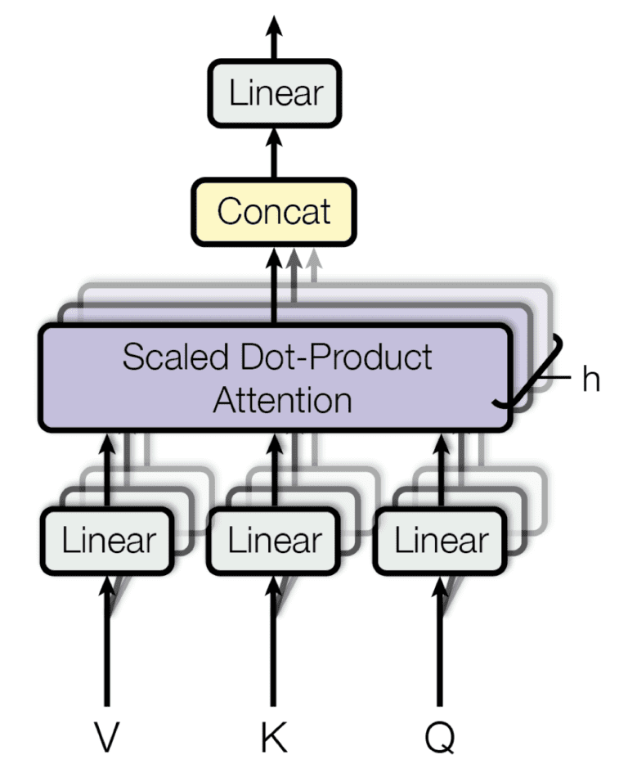
Multi-Head Attention

Slide 27
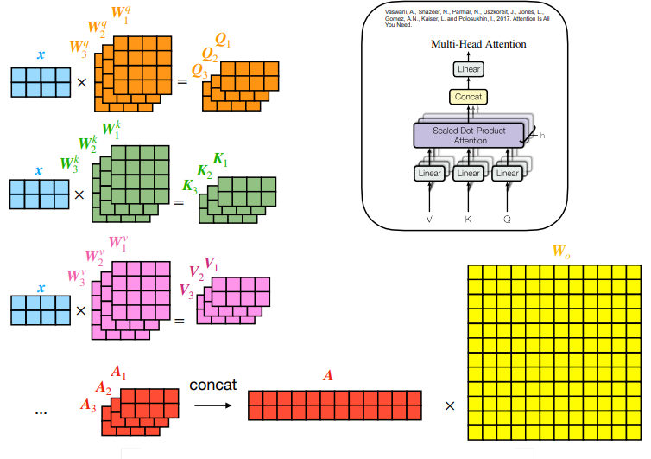
Multi-Head Attention
medium.com

Slide 28
Multi-Head Attention
Example:
Consider queries (Q), keys (K), and values (V) with dimensions 10 x 6
Model Dimensionality: 6 (embedding size)
Number of Heads: 3 (for this example)
Projection Dimension: d_{k}​=d_{v​}=2
Weight matrices: W_{Q},W_{K},W_{V} : need 3 set one for each head, its size is 6x2.

Slide 29
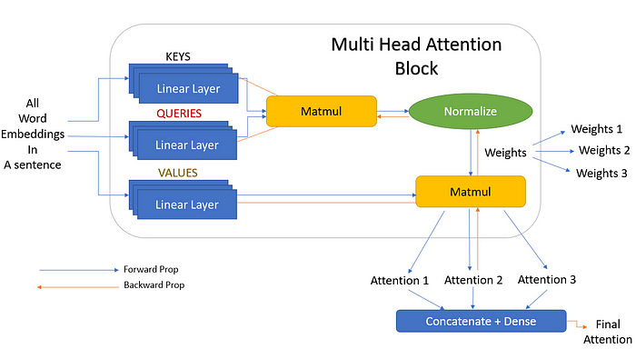
Multi-Head Attention
towardsdatascience.com

Slide 30
AN IMAGE IS WORTH 16X16 WORDS: TRANSFORMERS FOR IMAGE RECOGNITION AT SCALE Vision Transformer (ViT)

Slide 31
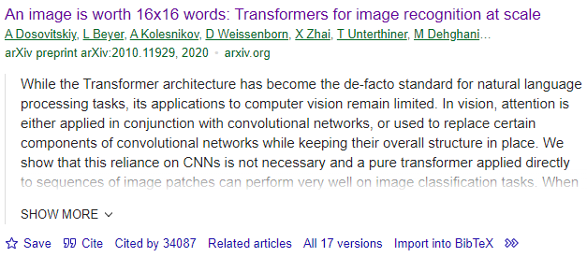
Vision Transformer (ViT)

Slide 32
Vision Transformer (ViT)
Transformer architecture has become the de-facto standard for natural language processing tasks
Its applications to computer vision remain limited.
In vision, attention is either applied in conjunction with convolutional networks
A pure transformer applied directly to sequences of image patches can perform very well on image classification tasks.
Vision Transformer (ViT) attains excellent results compared to state-of-the-art convolutional networks while requiring substantially fewer computational resources to train

Slide 33
Vision Transformer (ViT)
New way for applying a standard Transformer directly to images
Split an image into patches
Image patches are treated the same way as tokens (words) in an NLP application.
patch embeddings.
The ViT uses only the Encoder Part of Transformer
The Transformer uses constant latent vector size D through all of its layers, so we flatten the patches and map to D dimensions with a trainable linear projection

Slide 34
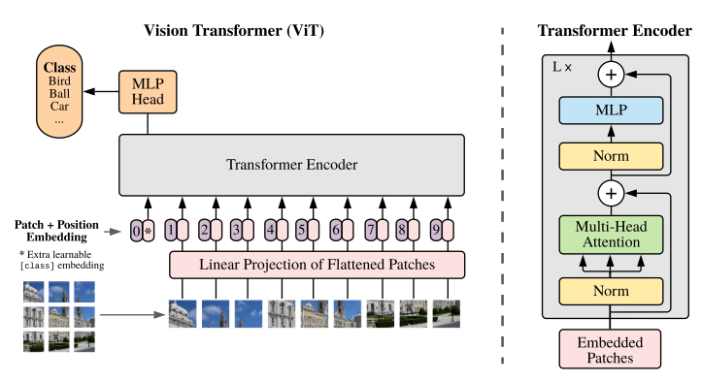
Vision Transformer (ViT)

Slide 35
Working: ViT
Split an image into patches:
The first step in processing an image with a Vision Transformer is to divide it into smaller, fixed-size patches.
sequence of linear embeddings of these patches as an input to a Transformer
Each patch represents a local region of the image.
Flatten the patches:
Pixel values are flattened into a single vector.
Treat image patches as sequential data.

Slide 36
Working: ViT
Produce lower-dimensional linear embeddings:
Pass these flattened patches via Linear Layer to transform into a lower-dimensional space.
Reduces the dimensionality of the data while preserving important features.
Generate positional encodings:
Positional encodings are generated and added to include the relative positions of different patches in the image.

Slide 37
Working: ViT
Transformer Encoder:
The input to a standard Transformer encoder comprises the sequence of patch embeddings and positional embeddings.
Layer normalization (LN) is applied to scale the data within the layer, ensuring stability and efficiency during training.
This encoder is composed of two main components:
Multi-head self-attention
Multi-layer perceptron (MLP) blocks.

Slide 38
Working: ViT
Gaussian Error Linear Unit (GELU)
An approximation to GELU is performed using
Classification Token:
The classification head is implemented by a MLP with one hidden layer
To enable image classification, a special "classification token" is prepended to the sequence of patch embeddings.
This token's state at the output of the Transformer encoder serves as the representation of the entire image.

Slide 39
Reading Task
Read the Vision Transformer Paper in Details:
Download Paper
Specifically look at these questions.
Why Vision Transformer has much less image-specific inductive bias than CNNs?
How the Hybrid Architecture is tested in ViT paper?
How Fine-Tuning is performed?
Explain what is self-supervised pre-training?
What challenges are highlighted by ViT paper?

Slide 40
Thank You ☺

